Slide 1
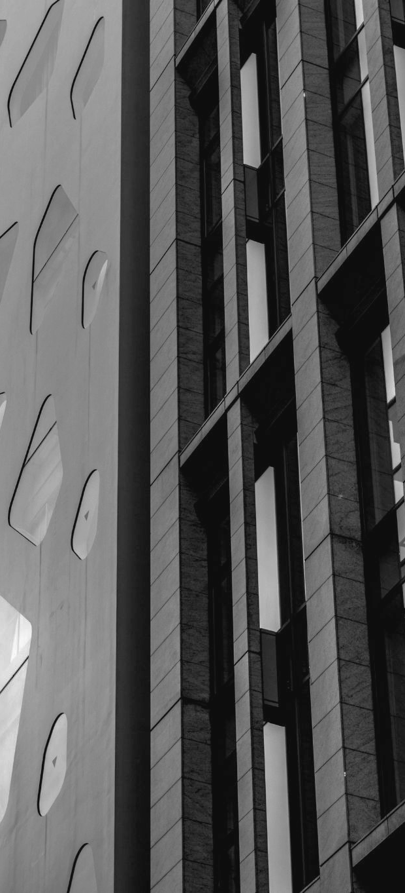

Where Design Meets Durability
Final Presentation
M.N.Pansuriya_Construction_Web

Slide 2

CIVIL ENGINEERING INDIAN COMPANY
M.N.Pansuriya_Construction_Web

Slide 3

01
ABOUT THE COMPANY
"Building Quality into Every Project"
M.N.Pansuriya_Construction_Web

Slide 4

ABOUT THE COMPANY
More than a decade since establishment, M.N Pansuriya through it’s subsidiaries, operates, constructs and maintains Indian Railways construction across the country
M.N.Pansuriya_Construction_Web

Slide 5

REVIEW OF PROJECT
some general aspects that could be included in a project scope for a civil engineering company web site development
M.N.Pansuriya_Construction_Web

Slide 6
Project Proposal
COMPANY NAME | M/s. M.N.Pansuriya (Engineers & Govt. Approved Construction)
USER-FRIENDLY DESIGN | website should have a clean, modern design that is easy for visitors to navigate. Make sure the layout is intuitive and the information is organized in a logical manner
SERVICES & PORTFOLIO | Highlight company's services and showcase examples of your past projects with images and descriptions. Visitors should be able to get a good sense of what your company does and the quality of your work.
CONTACT INFORMATION | Make it easy for potential customers to get in touch with you by including clear contact information, such as your phone number, email address, and physical address.
RESOURCES FAST LOADING SPEED | Your website should load quickly and efficiently, as visitors are likely to quickly leave if a page takes too long to load.
M.N.Pansuriya_Construction_Web

Slide 7
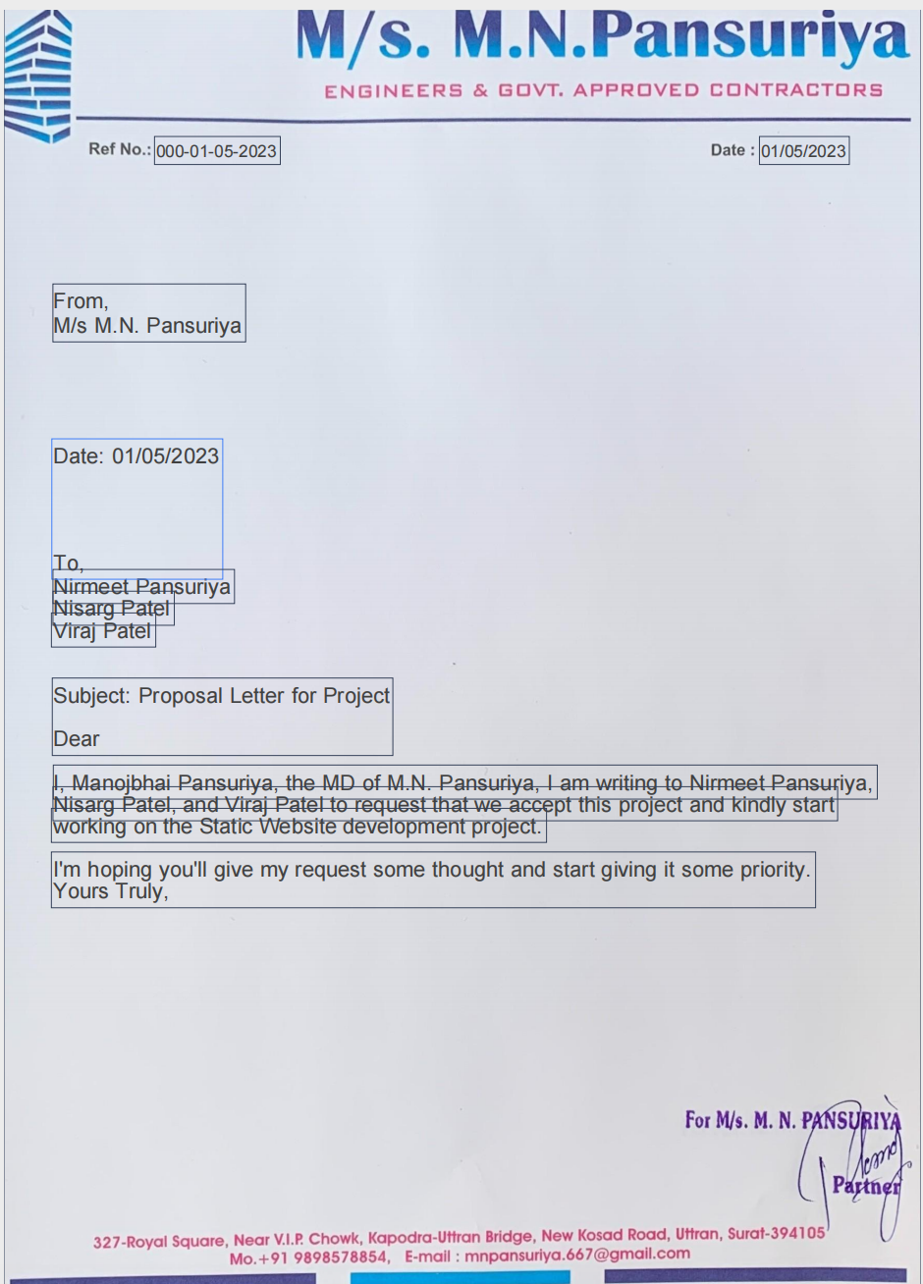
Proposal Document

Slide 8
REVIEW
Website Features
Website Structure and Navigation
List the specific features of the website, such as responsive design, user interface, content management system, social media integration, search engine optimization, and analytics.
Define the website's structure and navigation, including the site map, page layout, and menu structure.
Objectives and Goals
Content and Design
Define the objectives and goals of the website, including the target audience, messaging, and desired outcomes.
Specify the website's content and design requirements, including the visual style, graphics, images, and multimedia elements.
M.N.Pansuriya_Construction_Web

Slide 9
Technical Requirements
Quality Assurance
Define the quality assurance process to ensure the website's functionality, usability, and accessibility.
List the technical requirements of the website, such as web hosting, security, and maintenance
Project Timeline and Budget
FINAL DEPLOYMENT
Define the project timeline, milestones, and budget.
outlining all the necessary aspects of the website development process to ensure a successful outcome.
M.N.Pansuriya_Construction_Web

Slide 10
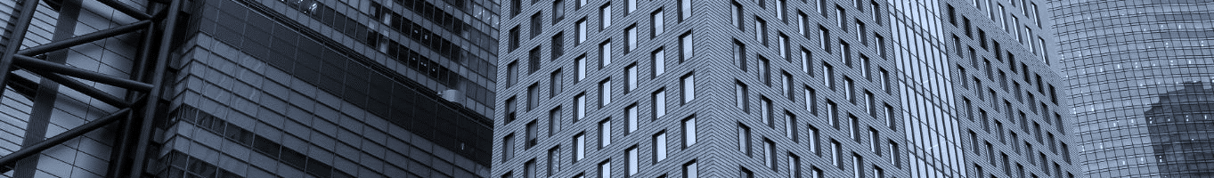
OUR PHILOSOPHY
MISSION
VISION
VALUES
Where Design Meets Durability
Elevating Expectations with Every Build
Expertly Constructed, Endlessly Durable
M.N.Pansuriya_Construction_Web

Slide 11
OUR REQUIRED TECHNOLOGY
MS Office
Adobe Creative Cloud
Including Teams, PowerPoint, Word, and Project
Figma, Illustrator, and Photoshop
Development stage
• HTML • CSS • Bootstrap • jQuery
M.N.Pansuriya_Construction_Web

Slide 12

Gantt Chart Timeline
Sr No. | Task Name | Duration | Start | Finish
1 | Initial Planning for project | 14 | 1/17/23 | 1/31/23
2 | Starting Phase | 19 | 1/31/23 | 2/5/23
3 | Designing Phase | 25 | 2/5/23 | 3/2/23
4 | Starting development | 33 | 3/2/23 | 4/4/23
5 | Final changes | 16 | 4/4/23 | 4/20/23
6 | Testing Phase | 2 | 4/21/23 | 4/23/23
7 | Final Deployment of project | 2 | 4/24/23 | 4/26/23

Slide 13
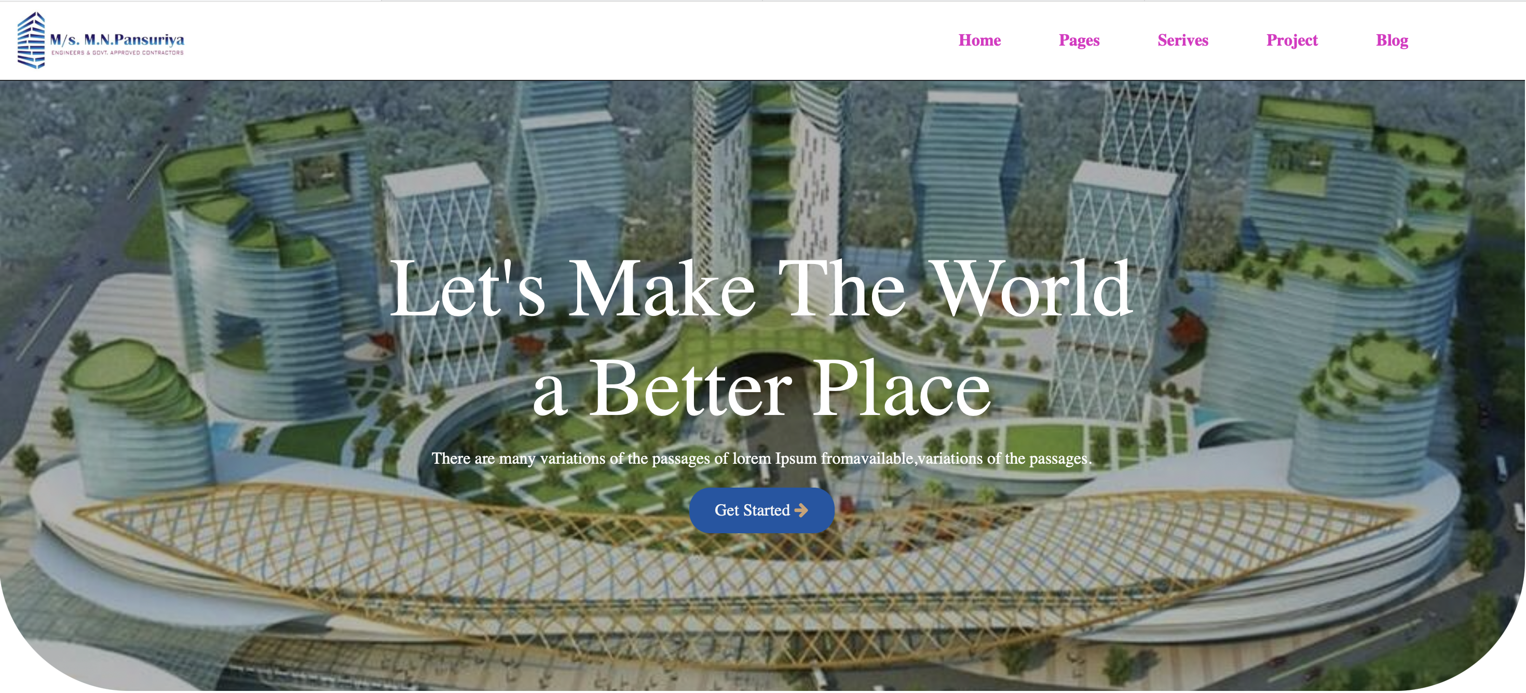
Home Page
Here, We have a 5 nav bar which includes the home, pages, services, project, Blog
M.N.Pansuriya_Construction_Web

Slide 14
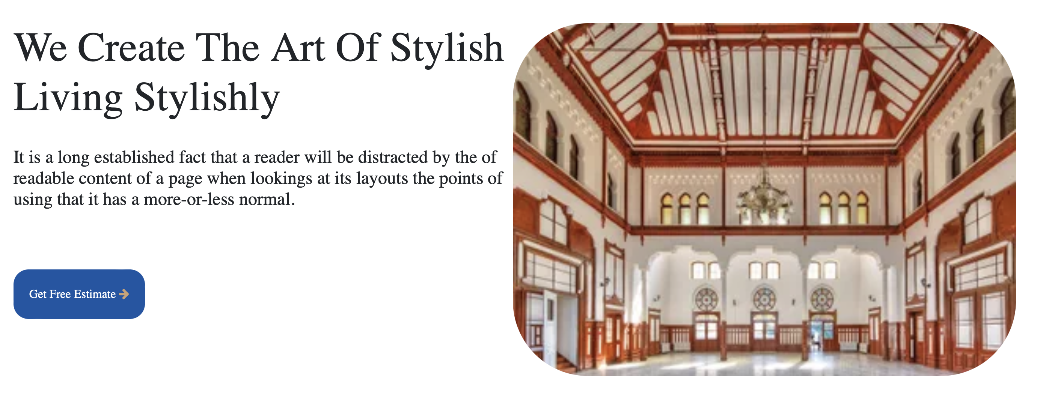
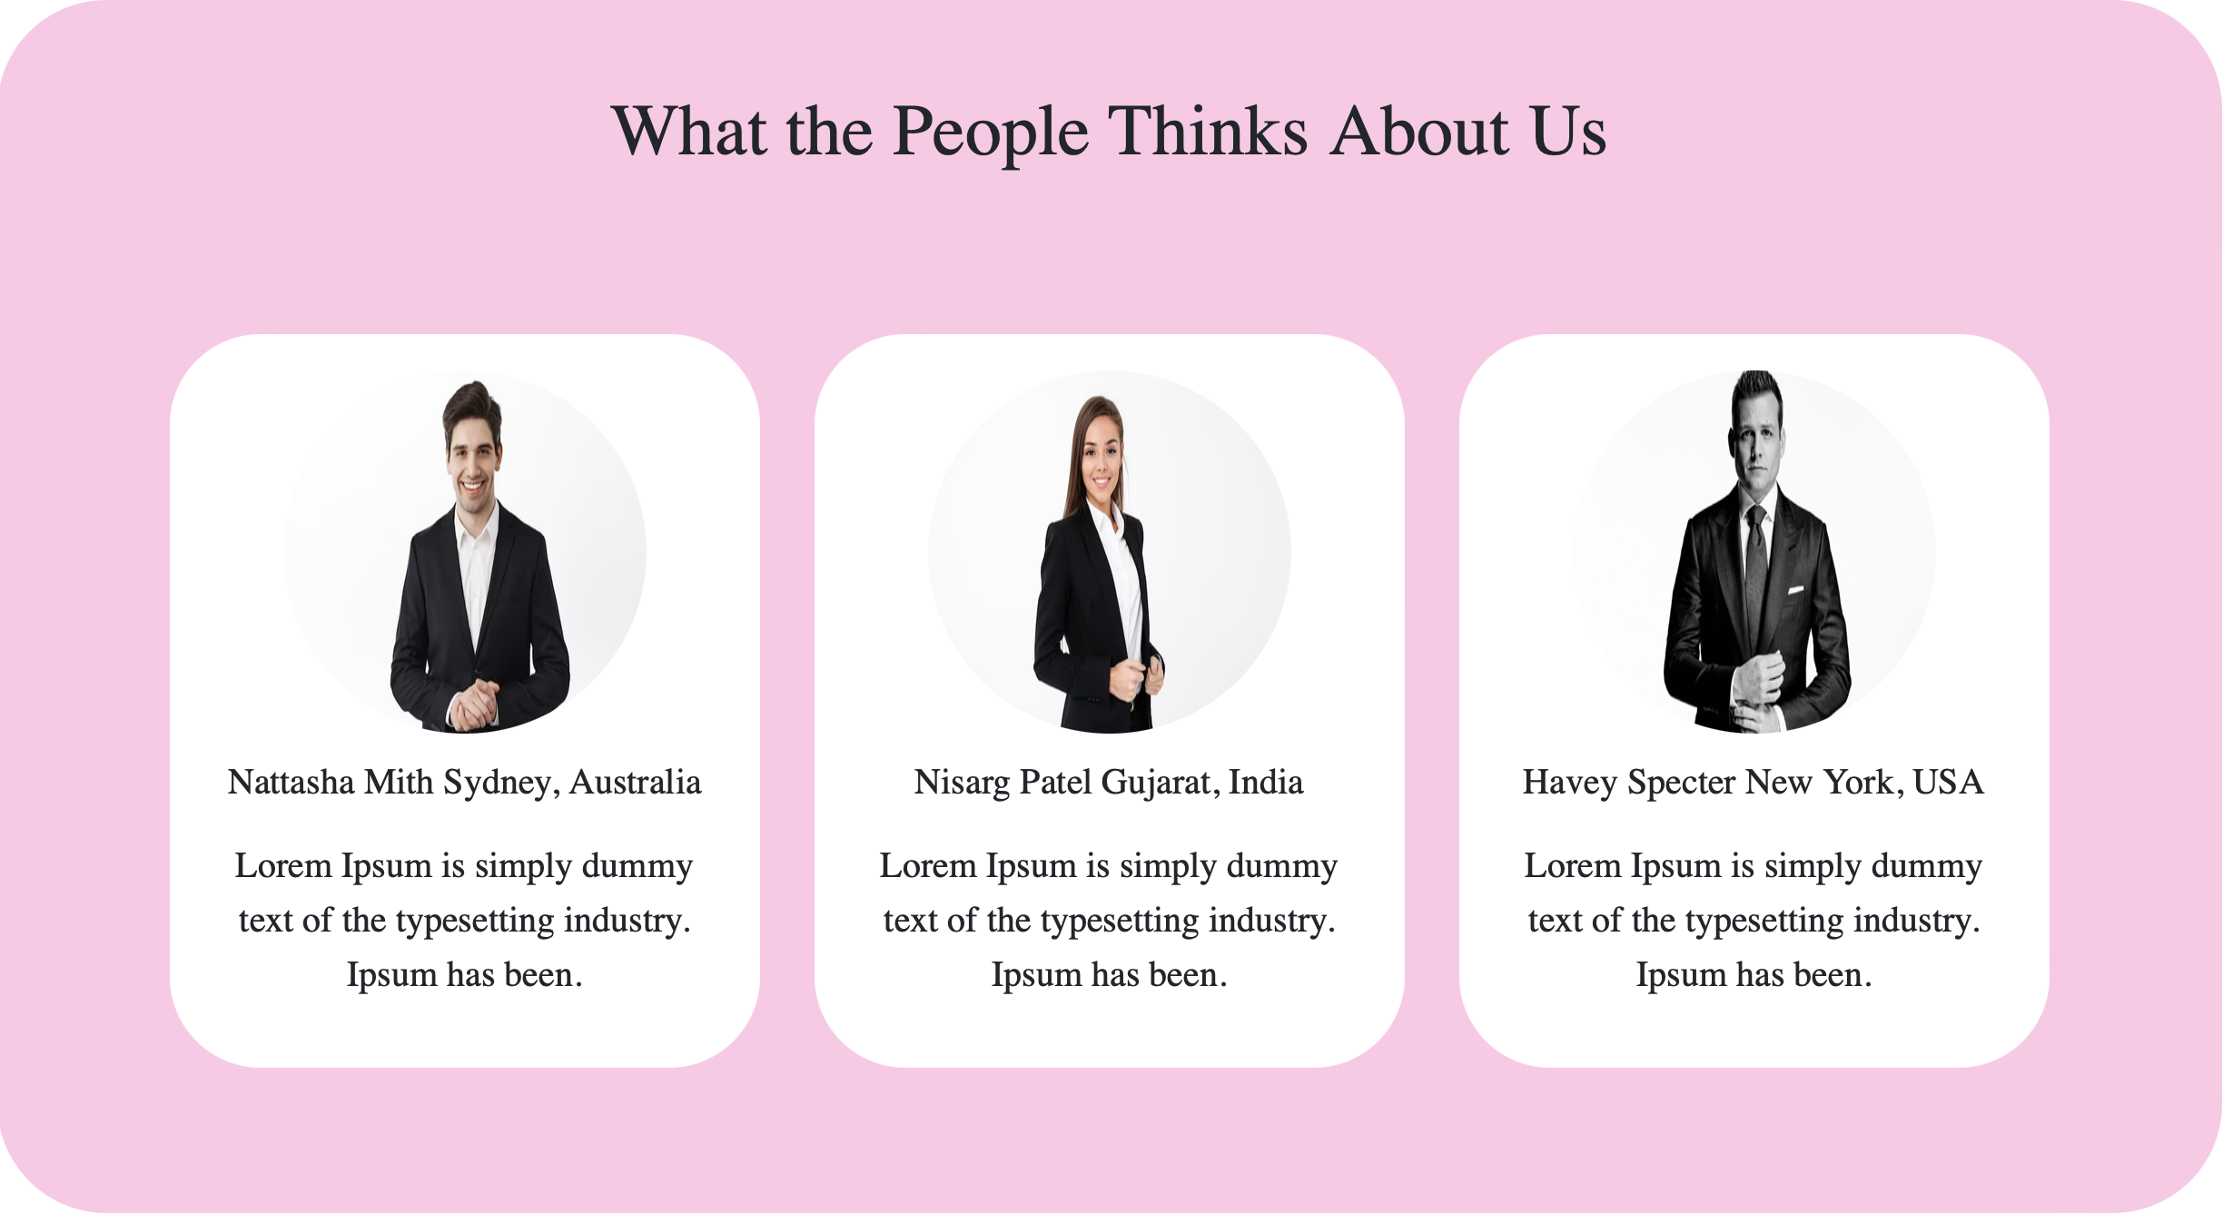
Other pages
M.N.Pansuriya_Construction_Web

Slide 15
For more info visit our site: website(https://mnpansuriya.netlify.app/)
General Information: So basically our site indicates clients working experience , portfolio and many more.
For example: Years of experience,
Success Project,
Active Project,
Happy Customer.
Developers : Nirmeet Pansuriya,
Nisarg Patel,
Viraj Patel,
Prem Parikh
M.N.Pansuriya_Construction_Web

Slide 16
Are there any questions?
JANA CARR
You can speak a bit about this person here
SHANE MAY
You can speak a bit about this person here
M.N.Pansuriya_Construction_Web

Slide 17
Thank You

